Slide 1
welcome to
COMP 2691
Intermediate Windows Application Development in .NET
Week 4
Serialization
Amir Ahani, M.Sc. + MBA
Microsoft Certified Solution Developer (MCSD .NET)
Microsoft Certified Database Administrator (MCDBA)
Email: amirahani@gmail.com
<number> of 48
Notes:
COMP2690 Windows Application Development with C#

Slide 2
Today…
  Serializing Objects
    What is Serialization?
    How to Serialize an Object?
    How to Deserialize an Object?
    How to Create Classes that can be Serialized?
    Choosing a Serialization Format
    How to use SoapFormatter?
    How to control SoapSerialization?
    Lab: Serialize and Deserialize Objects
<number> of 48
Notes:
COMP2690 Windows Application Development with C#

Slide 3
Today…
  XML Serialization
    Why use XML Serialization?
    How to use XML to Serialize an Object?
    How to use XML to Deserialize an Object?
    How to Control XML Serialization?
    How to Conform to an XML Schema?
    How to Serialize a DataSet?
    Lab: Using XML Serialization
<number> of 48
Notes:
COMP2690 Windows Application Development with C#

Slide 4
Serializing Objects
  If you want to store the contents of an object to a file,
  send an object to another process, or transmit it across
  the network, you have to think about how the object is
  represented because you will need to convert it to a
  different format. This conversion is called serialization.
<number> of 48

Slide 5
What is Serialization?
  Serialization, as implemented in the
  System.Runtime.Serialization namespace, is the
  process of serializing and deserializing objects so that
  they can be stored or transferred and then later re-
  created. Serializing is the process of converting an object
  into a linear sequence of bytes that can be stored or
  transferred. Deserializing is the process of converting a
  previously serialized sequence of bytes into an object.
<number> of 48

Slide 6
How to Serialize an Object?
  The steps for serializing an object are as follows:
  1. Create a stream object to hold the serialized output.
  2. Create a BinaryFormatter object (located in
  System.Runtime.Serialization.Formatters.Binary).
  3. Call the BinaryFormatter.Serialize method to serialize
  the object, and output the result to the stream.
<number> of 48

Slide 7
Example 1: (Serialization)
string data = "This must be stored in a file.";
// Create file to save the data to
FileStream fs = new FileStream("SerializedString.Data", FileMode.Create);
// Create a BinaryFormatter object to perform the serialization
BinaryFormatter bf = new BinaryFormatter();
// Use the BinaryFormatter object to serialize the data to the file
bf.Serialize(fs, data);
// Close the file
fs.Close();

Slide 8
Example 2: (Serialization)
// Create file to save the data to
FileStream fs = new FileStream("SerializedDate.Data", FileMode.Create);
// Create a BinaryFormatter object to perform the serialization
BinaryFormatter bf = new BinaryFormatter();
// Use the BinaryFormatter object to serialize the data to the file
bf.Serialize(fs, System.DateTime.Now);
// Close the file
fs.Close();

Slide 9
How to Deserialize an Object?
  The steps for deserializing an object are as follows:
  1. Create a stream object to read the serialized output.
  2. Create a BinaryFormatter object.
  3. Create a new object to store the deserialized data.
  4. Call the BinaryFormatter.Deserialize method to
  deserialize the object, and cast it to the correct type.
<number> of 48

Slide 10
Example 1: (Deserialization)
// Open file to read the data from
FileStream fs = new FileStream("SerializedString.Data",
FileMode.Open);
// Create a BinaryFormatter object to perform the deserialization
BinaryFormatter bf = new BinaryFormatter();
// Create the object to store the deserialized data
string data = "";
// Use the BinaryFormatter object to deserialize the data from the file
data = (string) bf.Deserialize(fs);
// Close the file
fs.Close();
// Display the deserialized string
Console.WriteLine(data);

Slide 11
Example 2: (Deserialization)
// Open file to read the data from
FileStream fs = new FileStream("SerializedDate.Data", FileMode.Open);
// Create a BinaryFormatter object to perform the deserialization
BinaryFormatter bf = new BinaryFormatter();
// Create the object to store the deserialized data
DateTime previousTime = new DateTime();
// Use the BinaryFormatter object to deserialize the data from the file
previousTime = (DateTime) bf.Deserialize(fs);
fs.Close(); // Close the file
// Display the deserialized time
Console.WriteLine("Day: " + previousTime.DayOfWeek + ", Time: "
+ previousTime.TimeOfDay.ToString());

Slide 12
How to Create Classes that Can be Serialized?
  You can serialize and deserialize custom classes by
  adding the Serializable attribute to the class. This is
  important to do so that you, or other developers using
  your class, can easily store or transfer instances of the
  class. Even if you do not immediately need serialization,
  it is good practice to enable it for future use. If you are
  satisfied with the default handling of the serialization, no
  other code besides the Serializable attribute is necessary.
  When your class is serialized, the runtime serializes all
  members, including private members.
<number> of 48

Slide 13
How to Disable Serialization of Specific Members?
[Serializable]
class ShoppingCartItem : IDeserializationCallback {
public int productId;
public decimal price;
public int quantity;
[NonSerialized] public decimal total;
public ShoppingCartItem(int _productID, decimal _price, int _quantity) {
productId = _productID;
price = _price;
quantity = _quantity;
total = price * quantity; }
void IDeserializationCallback.OnDeserialization(Object sender) {
// After deserialization, calculate the total
total = price * quantity; }
}
<number> of 48

Slide 14
How to Provide Version Compatibility?
  You might have version compatibility issues if you ever
  attempt to deserialize an object that has been serialized
  by an earlier version of your application. Specifically, if
  you add a member to a custom class and attempt to
  deserialize an object that lacks that member, the runtime
  will throw an exception. In other words, if you add a
  member to a class in version 3.1 of your application, it will
  not be able to deserialize an object created by version 3.0
  of your application.
<number> of 48

Slide 15
How to Provide Version Compatibility? (cont’d)
  To overcome this limitation, you have two choices:
  1- Implement custom serialization that is capable of importing earlier serialized objects.
  2- Apply the OptionalField attribute to newly added
  members that might cause version compatibility
  problems.
<number> of 48

Slide 16
Example: (Version Compatibility)
[Serializable]
class ShoppingCartItem : IDeserializationCallback
{
public int productId;
public decimal price;
public int quantity;
[NonSerialized] public decimal total;
[OptionalField] public bool taxable;

Slide 17
Best Practices for Version Compatibility
  1- Never remove a serialized field.
  2- Never apply the NonSerializedAttribute attribute to a field
  if the attribute was not applied to the field in a previous version.
  3- Never change the name or type of a serialized field.
  4- When adding a new serialized field, apply the OptionalFieldAttribute
  attribute.
  5- When removing a NonSerializedAttribute attribute from a field that
  was not serializable in a previous version, apply the
  OptionalFieldAttribute attribute.
  6- For all optional fields, set meaningful defaults using the serialization
  callbacks unless 0 or null as defaults are acceptable.
<number> of 48

Slide 18
Choosing a Serialization Format
  BinaryFormatter Located in the
  System.Runtime.Serialization.Formatters.Binary
  namespace, this formatter is the most efficient way to serialize
  objects that will be read by only .NET Framework–based
  applications.
  SoapFormatter Located in the
  System.Runtime.Serialization.Formatters.Soap
  namespace, this XML-based formatter is the most reliable way to
  serialize objects that will be transmitted across a network or read by
  non .NET Framework applications. SoapFormatter is more likely to
  successfully traverse firewalls than BinaryFormatter.
  (You need to add a reference to the System.Runtime.Serialization.Formatters.Soap.dll assembly to your project).
<number> of 48

Slide 19
How to Control SOAP Serialization?
  Binary serialization is intended for use only by .NET
  Framework–based applications. Therefore, there is rarely
  a need to modify the standard formatting. However,
  SOAP serialization is intended to be read by a variety of
  platforms. Additionally, you might need to serialize an
  object to meet specific requirements, such as predefined
  SOAP attribute and element names.
<number> of 48

Slide 20
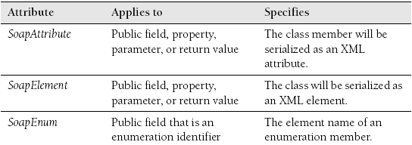
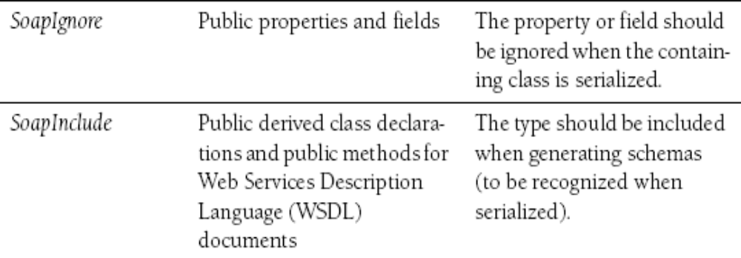
SOAP Serialization Attributes
<number> of 17

Slide 21
Guidelines for Serialization
  Keep the following guidelines in mind when using serialization:
  1- When in doubt, mark a class as Serializable. Even if you do not
  need to serialize it now, you might need serialization later. Or another
  developer might need to serialize a derived class.
  2- Mark calculated or temporary members as NonSerialized. For
  example, if you track the current thread ID in a member variable, the
  thread ID is likely to not be valid upon deserialization. Therefore, you
  should not store it.
  3- Use SoapFormatter when you require portability. Use
  BinaryFormatter for greatest efficiency.
<number> of 48

Slide 22
Lab: Serialize and Deserialize Objects
In this lab, you modify a class to enable efficient serialization and then update an application to perform serialization and deserialization of that class.
<number> of 17

Slide 23
XML Serialization
  XML is a standardized, text-based document format for
  storing application-readable information. Just as HTML
  provided a text-based standard for formatting
  human-readable documents, XML provides a standard
  that can be easily processed by computers.
  XML can be used to store any type of data, including
  documents (the latest version of Microsoft Office stores
  documents using XML), pictures, music, binary files, and
  database information.
<number> of 48

Slide 24
XML Serialization (cont’d)
  The .NET Framework includes several libraries for reading and
  writing XML files, including the System.Xml.Serialization namespace.
  System.Xml.Serialization provides methods for converting objects,
  including those based on custom classes, to and from XML files. With
  XML serialization, you can write almost any object to a text file for
  later retrieval with only a few lines of code. Similarly, you can use
  XML serialization to transmit objects between computers through
  Web services—even if the remote computer is not using the .NET
  Framework.
<number> of 48

Slide 25
Why use XML Serialization?
  Use XML serialization when you need to exchange an
  object with an application that might not be based on the
  .NET Framework, and you do not need to serialize any
  private members.
  XML serialization provides the following benefits over standard serialization:
  1- Greater interoperability
  2- More administrator-friendly
  3- Better forward-compatibility
<number> of 48

Slide 26
Why use XML Serialization? (cont’d)
  Greater interoperability
  XML is a text-based file standard, and all modern
  development environments include libraries for
  processing XML files. Therefore, an object that is
  serialized by using XML can be easily processed by an
  application written for a different operating system in a
  different development environment.
<number> of 48

Slide 27
Why use XML Serialization? (cont’d)
  More administrator-friendly
  Objects serialized by using XML can be viewed and
  edited by using any text editor, including Notepad. If you
  are storing objects in files, this gives administrators the
  opportunity to view and edit the XML file. This can be
  useful for customizing your application, troubleshooting
  problems, and developing new applications that
  interoperate with your existing application.
<number> of 48

Slide 28
Why use XML Serialization? (cont’d)
  Better forward-compatibility
  Objects serialized by using XML are self-describing
  and easily processed. Therefore, when the time comes to
  replace your application, the new application will have an
  easier time processing your serialized objects if you use
  XML.
<number> of 48

Slide 29
How to use XML to Serialize an Object?
  The steps for serializing an object are as follows:
  1. Create a stream, TextWriter, or XmlWriter object to
  hold the serialized output.
  2. Create an XmlSerializer object (in the
  System.Xml.Serialization namespace) by passing it the
  type of object you plan to serialize.
  3. Call the XmlSerializer.Serialize method to serialize the
  object and output the results to the stream.
<number> of 48

Slide 30
Example:
// Create file to save the data to
FileStream fs = new FileStream("SerializedDate.XML", FileMode.Create);
// Create an XmlSerializer object to perform the serialization
XmlSerializer xs = new XmlSerializer(typeof(DateTime));
// Use the XmlSerializer object to serialize the data to the file
xs.Serialize(fs, System.DateTime.Now);
// Close the file
fs.Close();

Slide 31
How to use XML to Deserialize an Object?
  The steps for Deserializing an object are as follows:
  1. Create a stream, TextReader, or XmlReader object to
  read the serialized input.
  2. Create an XmlSerializer object (in the
  System.Xml.Serialization namespace) by passing it the
  type of object you plan to deserialize.
  3. Call the XmlSerializer.Deserialize method to
  deserialize the object, and cast it to the correct type
<number> of 48

Slide 32
Example:
// Open file to read the data from
FileStream fs = new FileStream("SerializedDate.XML", FileMode.Open);
// Create an XmlSerializer object to perform the deserialization
XmlSerializer xs = new XmlSerializer(typeof(DateTime));
// Use the XmlSerializer object to deserialize the data from the file
DateTime previousTime = (DateTime)xs.Deserialize(fs);
fs.Close(); // Close the file
// Display the deserialized time
Console.WriteLine("Day: " + previousTime.DayOfWeek + ",
Time: " + previousTime.TimeOfDay.ToString());

Slide 33
How to Create Classes that can be Serialized by using XML Serialization?
  To create a class that can be serialized by using XML serialization,
  you must perform the following tasks:
  1- Specify the class as public.
  2- Specify all members that must be serialized as public.
  3- Create a parameterless constructor.
<number> of 48

Slide 34
How to Control XML Serialization?
  If you serialize a class that meets the requirements for
  XML serialization but does not have any XML
  serialization attributes, the runtime uses default settings
  that meet many people’s requirements. The names of
  XML elements are based on class and member names,
  and each member is serialized as a separate XML
  element.
<number> of 48

Slide 35
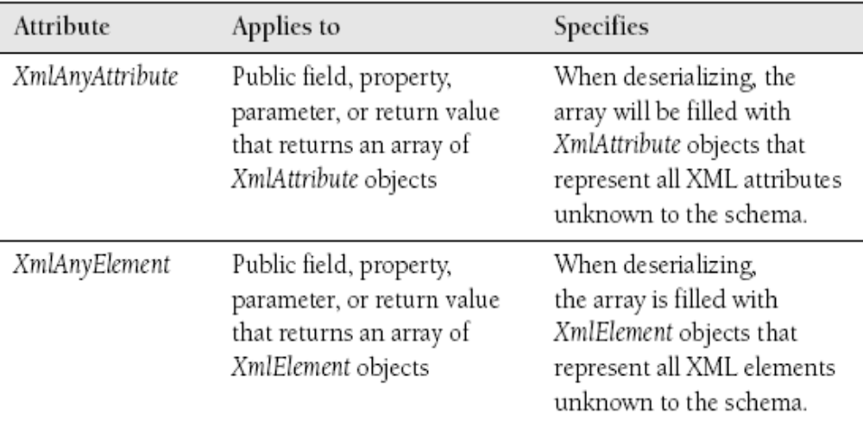
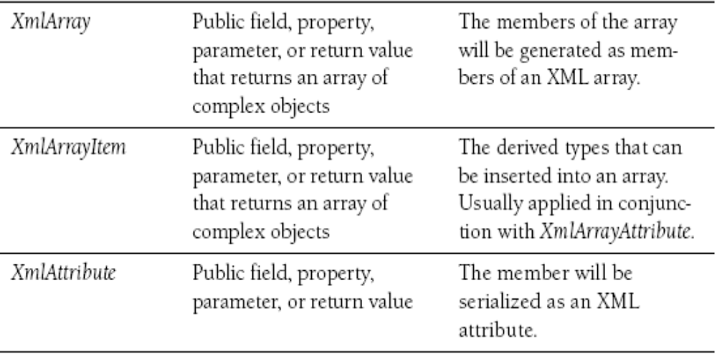
XML Serialization Attributes:
<number> of 17

Slide 36
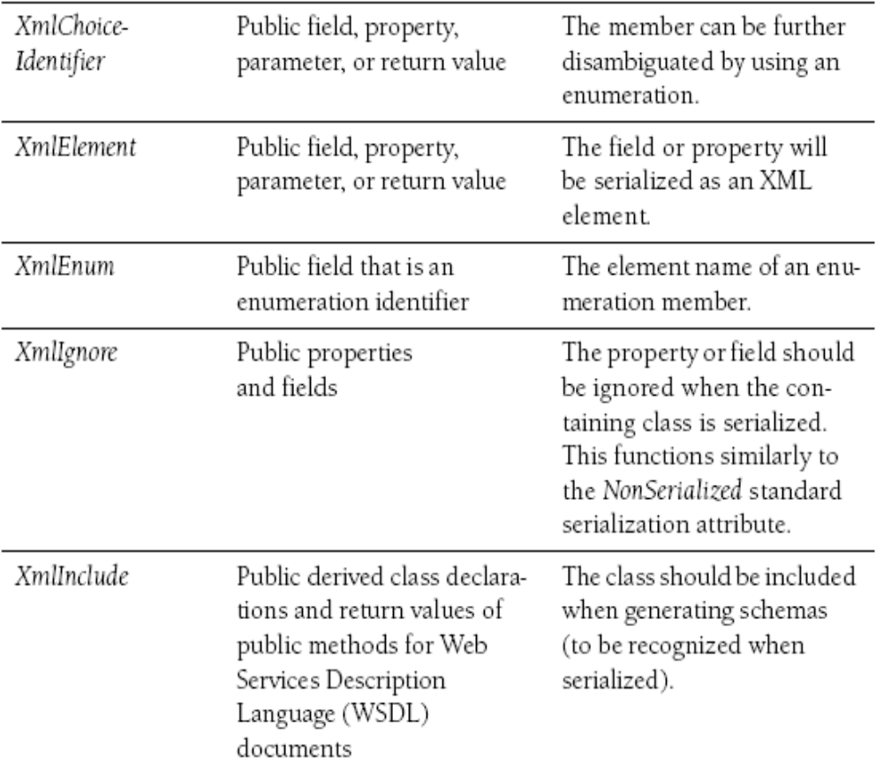
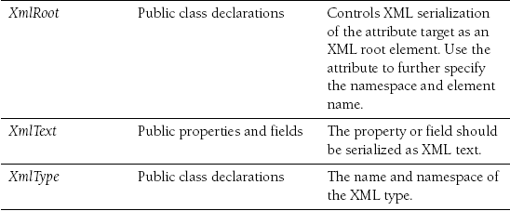
XML Serialization Attributes: (cont’d)
<number> of 17

Slide 37
XML Serialization Attributes
  These attributes can be used to make a serialized class conform to
  specific XML requirements. For example, consider the attributes
  required to make the following three changes to the serialized XML
  document:
  1- Change the ShoppingCartItem element name to CartItem.
  2- Make productId an attribute of CartItem, rather than a separate
  element.
  3- Do not include the total in the serialized document.
<number> of 48

Slide 38
XML Serialization Attributes (cont’d)
[XmlRoot ("CartItem")]
public class ShoppingCartItem
{
  [XmlAttribute] public Int32 productId;
  public decimal price;
  public Int32 quantity;
  [XmlIgnore] public decimal total;
public ShoppingCartItem()
{
}
}
<?xml version=“1.0” ?>
<CartItem productId=“100”>
<price>10.25</price>
<quantity>2</quantity>
</CartItem>
<number> of 48

Slide 39
How to Conform to an XML Schema?
  Typically, when two different applications are going to
  exchange XML files, the developers work together to
  create an XML schema file. An XML schema defines the
  structure of an XML document. Many types of XML
  schema already exist, and whenever possible, you should
  leverage an existing XML schema.
<number> of 48

Slide 40
How to Conform to an XML Schema?
  If you have an XML schema, you can run the XML
  Schema Definition tool (Xsd.exe) to produce a set of
  classes that are strongly typed to the schema and
  annotated with attributes. When an instance of such a
  class is serialized, the generated XML adheres to the
  XML schema.
  This is a simpler alternative to using other classes in the
  .NET Framework, such as the XmlReader and XmlWriter
  classes, to parse and write an XML.
<number> of 48

Slide 41
Generate a class based on a schema
1. Create or download the XML schema .xsd file on your computer.
  2. Open a Visual Studio 2005 Command Prompt.
  3. From the Visual Studio 2005 Command Prompt, run
  Xsd.exe schema.xsd /classes /language:[CS | VB].
  For example, to create a new class based on a schema file named
  C:\schema\library.xsd, you would run the following command:
  xsd C:\schema\library.xsd /classes /language:CS
  4. Open the newly created file (named Schema.CS or Schema.VB),
  and add the class to your application.
<number> of 48

Slide 42
Responding to Serialization Events
  The .NET Framework 2.0 supports binary serialization events when
  using the Binary-Formatter class. These events call methods in your
  class when serialization and deserialization take place. There are
  four serialization events:
  1- Serializing
  2- Serialized
  3- Deserializing
  4- Deserialized
<number> of 48

Slide 43
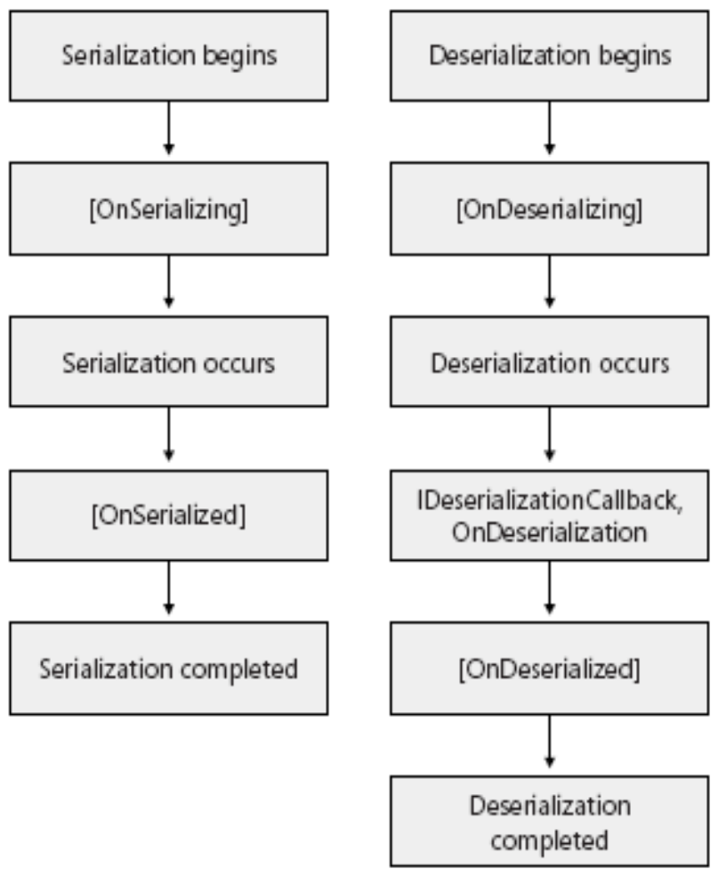
Responding to Serialization Events

Slide 44
How to Serialize a DataSet?
  Besides serializing an instance of a public class, an
  instance of a DataSet object can also be serialized.
<number> of 48

Slide 45
Example
private void SerializeDataSet(string filename)
{
  XmlSerializer ser = new XmlSerializer(typeof(DataSet));
  // Creates a DataSet; adds a table, column, and ten rows.
  DataSet ds = new DataSet("myDataSet");
  DataTable t = new DataTable("table1");
  DataColumn c = new DataColumn("thing");
  t.Columns.Add(c);
  ds.Tables.Add(t);
  DataRow r;
  for(int i = 0; i<10;i++)
  {
    r = t.NewRow();
    r[0] = "Thing " + i;
    t.Rows.Add(r);
  }
  TextWriter writer = new StreamWriter(filename);
  ser.Serialize(writer, ds);
  writer.Close();
}
<number> of 48

Slide 46
Lab: Using XML Serialization
In this lab, you will update an application that currently uses BinaryFormatter serialization to use XML serialization.
<number> of 48

Slide 47
Summary
  Serialization is the process of converting information into a byte stream
  that can be stored or transferred.
  To serialize an object, first create a stream object. Then create a
  BinaryFormatter object and call the BinaryFormatter.Serialize method. To
  deserialize an object, follow the same steps but call the
  BinaryFormatter.Deserialize method.
  To create a class that can be serialized, add the Serializable attribute. You
  can also use attributes to disable serialization of specific members.
  SoapFormatter provides a less efficient, but more interoperable, alternative
  to the BinaryFormatter class.
  To use SoapFormatter, follow the same process as you would for
  BinaryFormatter, but use the
  System.Runtime.Serialization.Formatters.Soap.SoapFormatter class.
  You can control SoapFormatter serialization by using attributes to specify
  the names of serialized elements and to specify whether a member is
  serialized as an element or an attribute.
<number> of 48

Slide 48
Summary
  XML serialization provides the interoperability to communicate with
  different platforms and the flexibility to conform to an XML schema.
  XML serialization cannot be used to serialize private data or object
  graphs.
  To serialize an object, first create a stream, TextWriter, or
  XmlWriter. Then create an XmlSerializer object and call the
  XmlSerializer.Serialize method. To deserialize an object, follow the
  same steps but call the XmlSerializer.Deserialize method.
  To create a class that can be serialized, specify the class and all
  members as public, and create a parameterless constructor.
  You can control XML serialization by using attributes. Attributes can
  change the names of elements, serialize members as
  attributes rather than elements, and exclude members from serialization.
  Use the Xsd.exe tool to create a class that will automatically conform to an
  XML schema when serialized.
  Datasets, arrays, collections, and instances of an XmlElement or XmlNode
  class can all be serialized with XmlSerializer.
<number> of 48

